Slide 1

AI Based District Profiling System
User Manual
Author: Panav Kalra
Notes:
Preworks course home assignments

Slide 2
Table of Contents
Acknowledgements
About Me
My Journey
About the App
How to Use the App?
Contact
Ending slide

Slide 3
Acknowledgements
I would like to thank Avishek Sir for guiding me through this project. I would also like to thank my Parents for their support and the sites I used to procure the data for the ML training (Kaggle etc).

Slide 4

About Me..
Student’s Photograph
Student’s Introduction
I am Panav, I am a 12th grader from Gurgaon, India. I love business and creating social impact.
hhh

Slide 5
About My Internship Journey with Clevered..
I have had a very enriching experience with clevered. They helped my learn new concepts about AI and also helped me build something for the community.

Slide 6
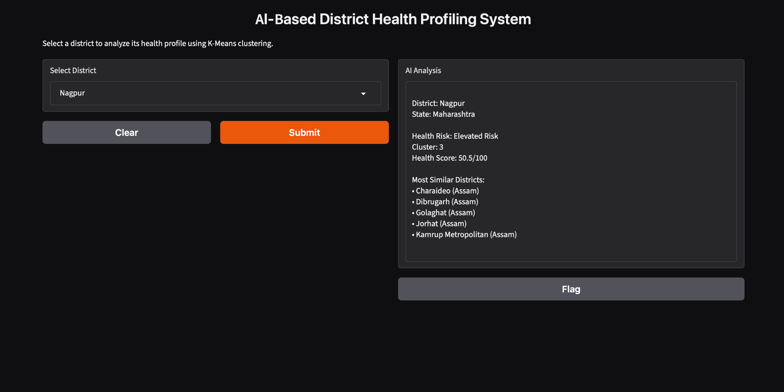
About the App..
App’s Main Menu
App’s Introduction
An AI-driven platform analyzing 104 NFHS-5 indicators to identify and visualize healthcare access gaps across Indian districts.

Slide 7
How do I use the App?
How to Use
Select a district from the interactive option.
View its health profile across the 104 NFHS-5 indicators.
Check the district's health score and cluster classification.
Compare districts to identify areas with greater healthcare access gaps.
Use the insights to understand regional healthcare needs and prioritize areas for further analysis.

Slide 8
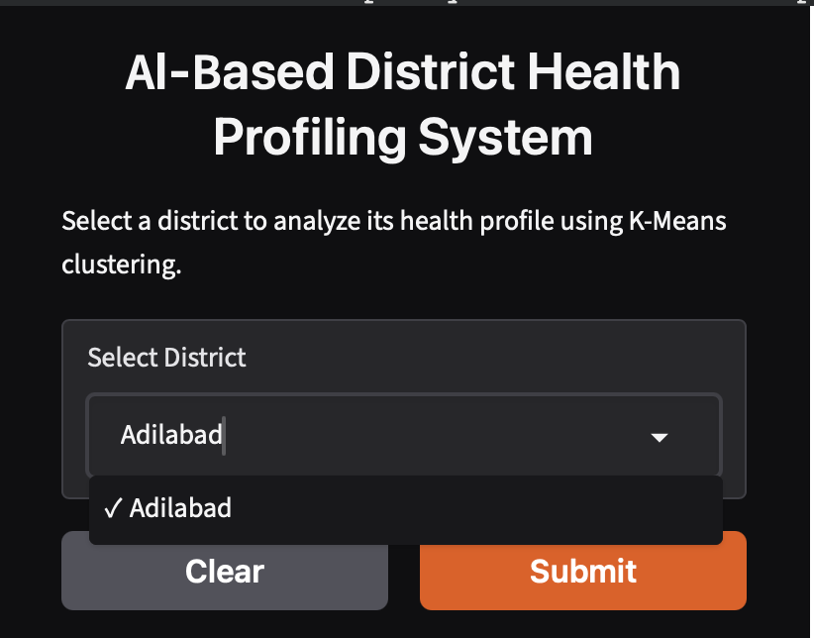
Option- District Selection
Select a district in india from the district selector option and click submit.
The app shows the results as per the district entered by the user.

Slide 9
Contact Person
Feel free to reach out for any queries/suggestions/ ideas-
Email: kalrapanav@gmail.com

Slide 10
Thank you!

